Slide 1


EXPLORATORY DATA ANALYSIS OF HEALTHCARE DISTRIBUTION BY REGION
By Cubeoid Group
Esteban, Fernandez, Sanchez, Tandayu, Valleser

Slide 2
INTRODUCTION
In the 21st Century, health care systems across the world are focusing policy efforts on improving the quality of healthcare delivered to their population. This encompasses the entire system and industry dedicated to providing medical services to individuals and communities. It includes not only the medical services themselves but also the infrastructure, policies, and entities that support the delivery of these services. Understanding healthcare is crucial for patients and caregivers to navigate the system effectively and advocate for high-quality care. This will explore the components of healthcare, explain the difference between healthcare and health care, provide examples, and highlight how patients and caregivers can optimize their interactions with the healthcare system. Healthcare refers to the comprehensive system and industry involved in the provision of medical services (What Is Healthcare?, n.d.).
1

Slide 3
WHY WE MADE THE STUDY
The project was created to provide a visualization and interpretation of data concluded regarding Healthcare Distribution by Region in order to depict a simple to in depth understanding of how well the Healthcare Distribution in most regions are, and how well they perform with those Healthcare Distributions.
2

Slide 4
RELEVANCE OF THE STUDY
Health care is the sum of preventive services and measures provided by the Directorate of Basic Health Care and its affiliated institutions to all members of the society at large in order to raise the health level of the community and prevent diseases and spread, including the provision of services that help to improve the general health level. Keep the environment clean and the water safe from pollution. Caring for mothers during pregnancy and childbirth, taking care of feeding children and vaccinating them with the necessary vaccines on time.
Access to healthcare is a fundamental necessity, and pharmacies play a vital role in delivering essential medications to each community. This analysis aims to evaluate the distribution of pharmacies across different regions, identify potential disparities, and provide insights for improving regional healthcare infrastructure.
3

Slide 5
STATEMENT OF THE PROBLEM
The primary objective of this research is to analyze healthcare data to determine:
Which regions have the highest and lowest number of healthcare services and professionals, such as for hospitals, clinics, and pharmacies.
Identify disparities in healthcare services and professionals distribution across the regions.
How this analysis can guide decisions for equitable healthcare access.
By addressing these questions, this study contributes to identifying underserved areas and informing policies for equitable distribution of healthcare resources.
4

Slide 6
SCOPE AND DELIMITATION
SCOPE
DELIMITATION
Reffered to the original csv files for reliable interpretation.
Availability Dataset - Includes details on the availability of healthcare professionals and healthcare facilities in the specified locations.
Limited to information gathered through the original csv files
The analysis is limited to the regions and locations factored in the provided datasets. Locations outside the scope of the data will not be considered.
5

Slide 7
OBJECTIVES
The general objectives are as follows:
To visualize and interpret the data gathered through Visualizations and Data Analysis.
To develop an understanding of how well the Healthcare Distribution in most regions are, and how well they perform with those Healthcare Distributions.
To plot different figures using the data gathered.
6

Slide 8
METHODOLOGY
Data Evaluation
- Each datasets utilized were assessed to determine its relevance to the research objectives. The necessary datasets were imported into Python Colab for analysis. The chosen datasets were examined to identify their structure, including the number of rows, columns, and variable types.
Data Integration
- The two datasets, “Location Dataset” and “OSM POI Health Dataset”, were merged with the “adm4_pcode” column. This integration allowed pharmacy counts and other health metrics from the health dataset to be associated with corresponding regional attributes in the location dataset. After ensuring the data consistency, the merged dataset was grouped by “adm1_en” (regional names) to calculate the total pharmacy count for each region.
7

Slide 9
METHODOLOGY
Data Visualization
- The bar charts was utilized to display the pharmacy distribution across regions. And it was chosen for their effectiveness in representing categorical data and their ability to highlight disparities visually.
- The chart included features such as:
Rotated x-axis labels to improve readability.
Gridlines to enhance the interpretation of the data.
Color differentiation to make the charts visually appealing and clear.
Statistical Treatment
- The study involved the use of descriptive statistics to analyze the number of professionals and facilities in each region. The aim of descriptive statistics is to summarize categorical and numerical data in an informative way, which is used to help describe key features or characteristics of data (Green et al., 2022).
8

Slide 10
RESULTS
In Figure 1.1, it shows that Region XI has the highest number of doctors with 353, while Region III has none.
In Figure 1.2, it shows that NCR leads in the number of opticians with 53, while Regions III, VII, VIII, IX, and X have none.
In Figure 1.3, it shows that NCR has the most dentists with 135, while Region III has none.
In Figure 1.4, it shows that Region IX has the highest number of hospitals with 272, while Region III has the lowest with 3.
In Figure 1.5, it shows that Region XI has the highest number of clinics with 14, while all other regions (Region I, Region II, Region III, Region IV, Region V, Region VI, Region VII, Region VIII, Region IX, Region X, and NCR) have none.
In Figure 1.6, it shows that Region XI has the highest number of pharmacies with 1,033, while Region III has none. Region XI stands out across multiple healthcare categories, with a high count of doctors, dentists, clinics, and pharmacies.
9

Slide 11
DISCUSSION
The analysis identified disparities in pharmacy distribution across regions. Region XI emerged as the region with the highest number of pharmacies, having approximately 1,000 facilities. It was followed by the National Capital Region (NCR) with around 600 pharmacies. These regions benefit from higher levels of urbanization and larger population densities, leading to better access to healthcare resources. On the other hand, Region VIII had the lowest number of pharmacies, indicating potential healthcare access challenges. Other regions, such as Region V, also demonstrated relatively low pharmacy counts. These findings highlight a clear divide between urban and rural areas, with urbanized regions having significantly better access to healthcare infrastructure.
The observed disparities across regions highlight the significant imbalances in healthcare infrastructure and the availability of professionals, this reflect on a need for targeted interventions in underserved areas. The organizations should focus on building more healthcare facilities, encouraging professionals to work in these regions, and making sure medicines and equipment are available.
10

Slide 12
CONCLUSION
The study demonstrated an uneven distribution of healthcare resources distribution across regions, with urban areas such as Region XI and NCR having abundant resources, while rural regions like Regions III and VIII face severe shortages. Region XI stands out with the highest number of doctors (353), clinics (14), and pharmacies (1,033), while Region III lacks any doctors, clinics, or pharmacies. Similarly, NCR leads in opticians (53) and dentists (135), but several regions, including III, VII, VIII, IX, and X, have no opticians. Region IX has the highest number of hospitals (272), whereas Region III has only three.
These results reveal not just a shortage of physical healthcare infrastructure in certain areas but also significant gaps in healthcare professionals, which intensifies the disparities. In particular, the lack of healthcare infrastructure in rural areas limits employment opportunities for healthcare professionals and creates a cycle of limited service provision, making it difficult for disadvantaged regions to attract healthcare workers. This problem is especially evident in Region III, which faces the most critical gaps in both healthcare services and personnel.
11

Slide 13
CONCLUSION
To address these disparities, the study suggests prioritization of investments in healthcare infrastructure and personnel in disadvantaged regions like Region III. The policymakers are encouraged to develop programs that motivate healthcare professionals to serve in rural areas through financial benefits or career development opportunities. Additionally, addressing population density and geographical challenges is crucial to ensuring that healthcare services are accessible to all. By targeting these gaps, healthcare access and outcomes can be significantly improved, promoting equity across all regions.
12

Slide 14
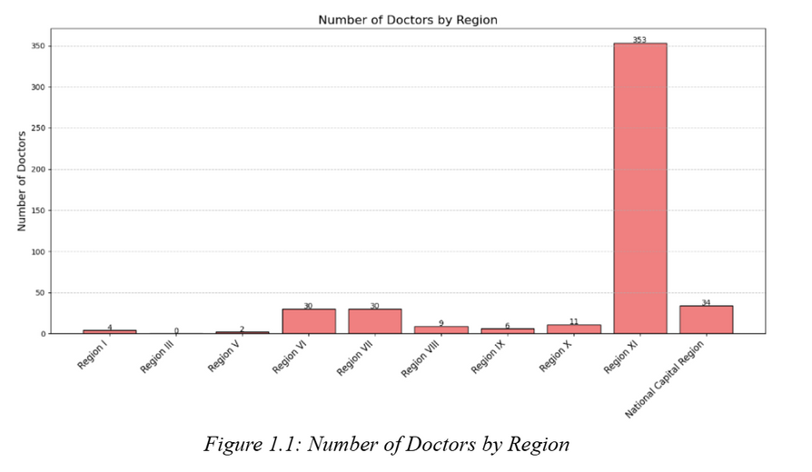
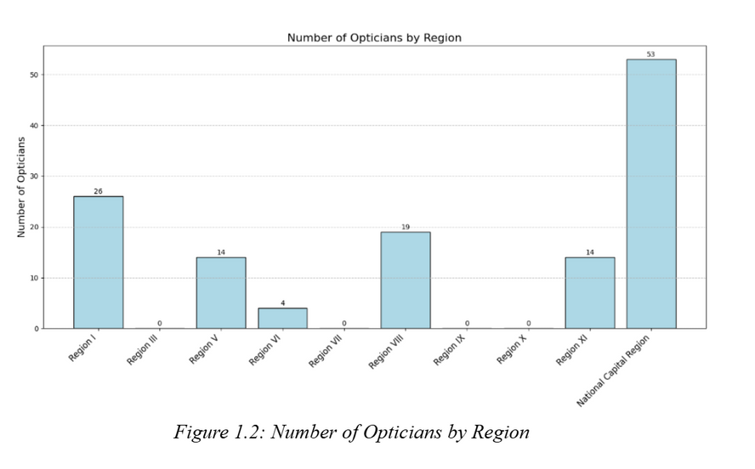
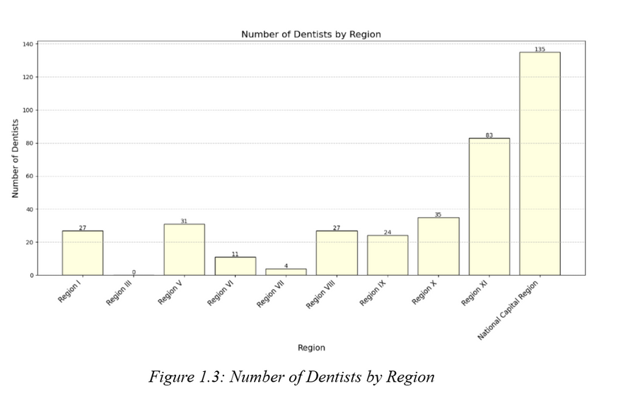
OUTPUTS
13

Slide 15
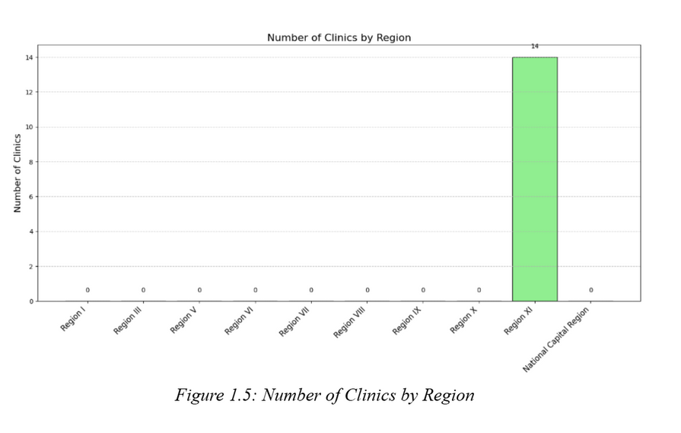
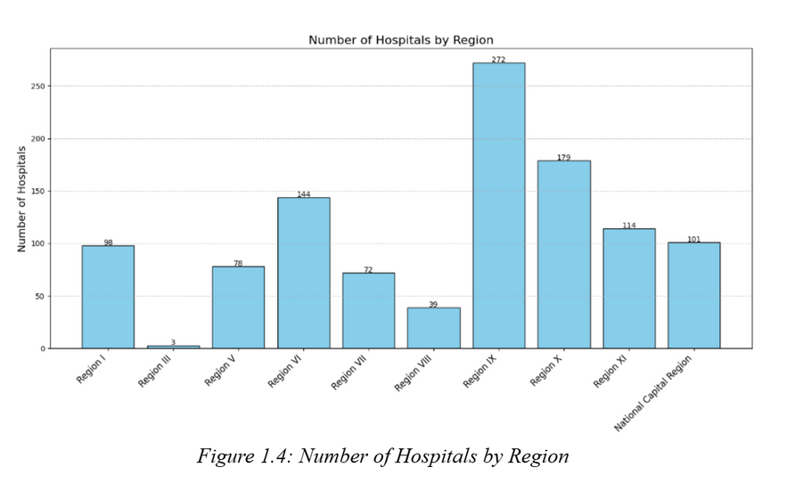
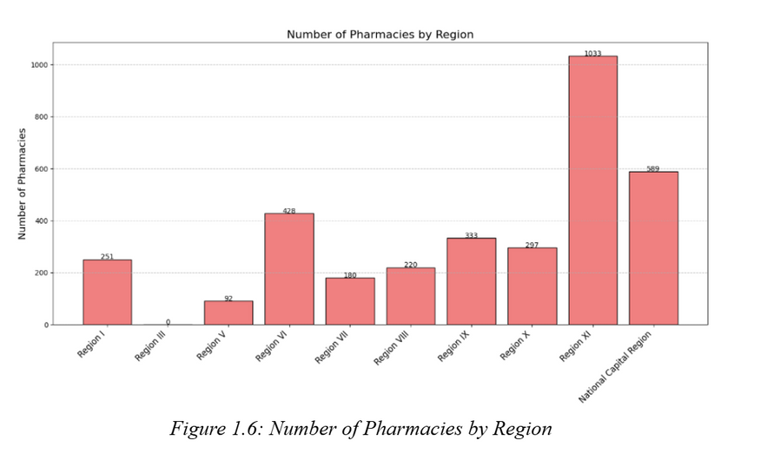
OUTPUTS
14

